Slide 1
Working with Arrays

Slide 2
Java Primitive Arrays
int[] ids = new int[10];
Type Array Variable Name Size
int[] ids = new int[] {54, 22, 37, 1, 99};
0 1 2 3 4
int[] ids = {54, 22, 37, 1, 99};

Slide 3
Array Value Allocation
int[] ids = new int[10];
Element Index
String[] instruments = new String[]{"guitar", "drums", "bass"}
0 | 0 | 0 | 0 | 0 | 0 | 0 | 0 | 0 | 0
0 | 1 | 2 | 3 | 4 | 5 | 6 | 7 | 8 | 9
"guitar"
"drums"
"bass"
Index
0 | 1 | 2

Slide 4



Assisted Practice: Searching Arrays
Element in sorted array - returns valid index position
Element NOT in sorted array - returns negative number
Array not sorted - unpredictable result

Slide 5
Understanding Array Comparison
array1.equals(array2);
Memory address comparison
Arrays.equals(array1, array2);
Same elements in same order comparison
Arrays.compare(array1, array2); Smaller, equals, bigger comparison
Arrays.mismatch(array1, array2); Comparison to find where arrays differ

Slide 6
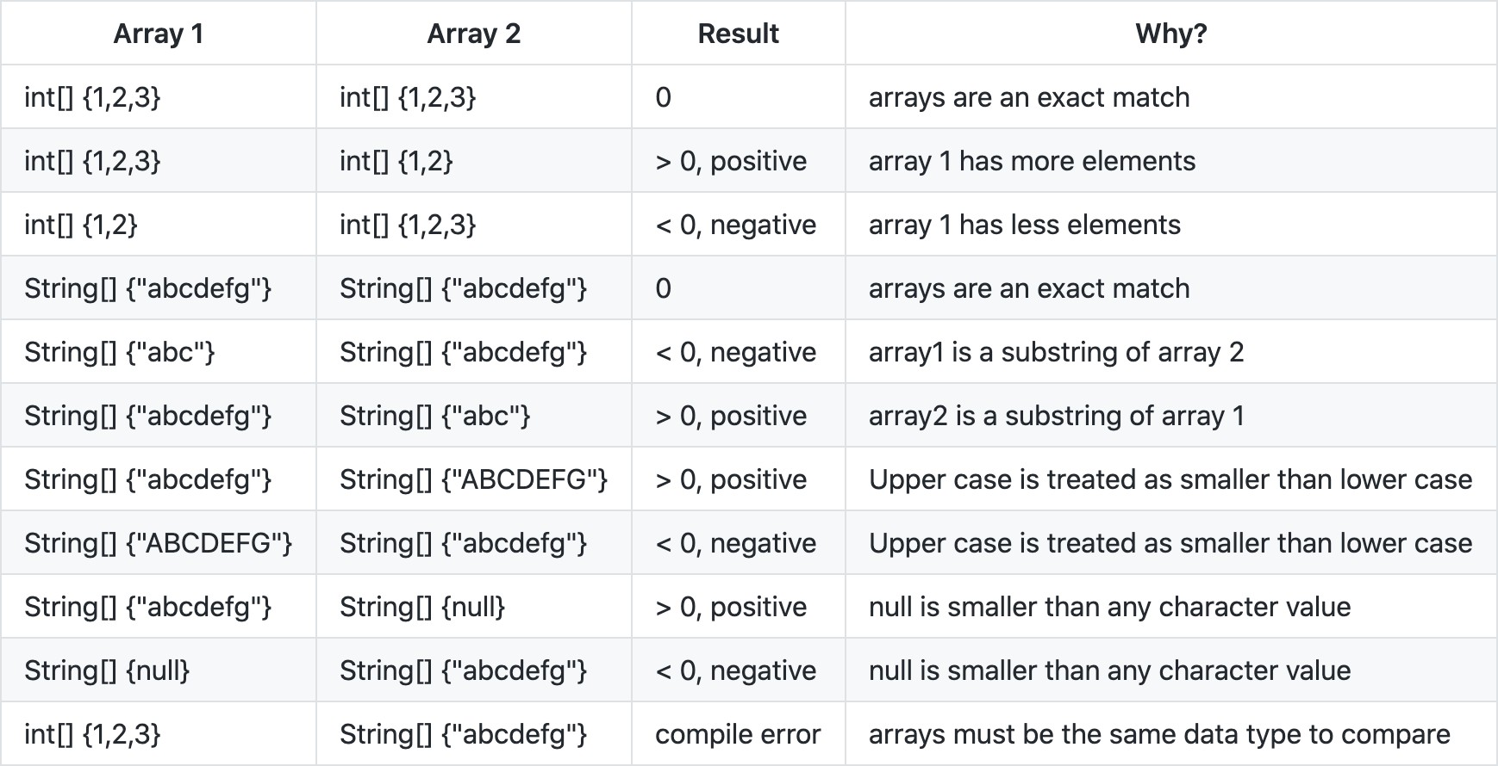
Understanding Array Comparison

Slide 7

Summary
Declaring single and multidimensional arrays
Iterating, sorting and searching arrays
Arrays
Array comparisons with equals, compare and mismatch methods

